Slide 1
Optimization
Yaw Control System
Pitching Control System

Slide 2
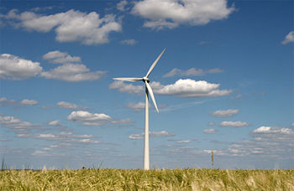
Wind turbine is a sophisticated system of component that must all work together to efficiently power production.
Like most sophisticated systems it can be divided into sections.
Some sections are dedicated to capture the wind energy, other sections convert the mechanical kinetic energy to electrical energy .
All of the sections depends on a control system to keep the turbine facing into the wind and turning at proper rate.

Slide 3
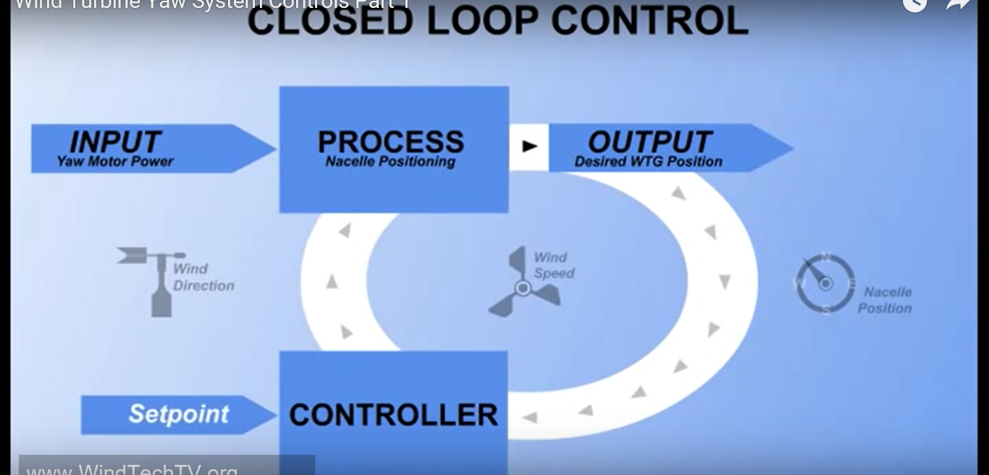
-closed loop control system
-The closed loop control system measure variables that affect system performance and compare this measurements to desired performance which is called (SETPOINT).

Slide 4
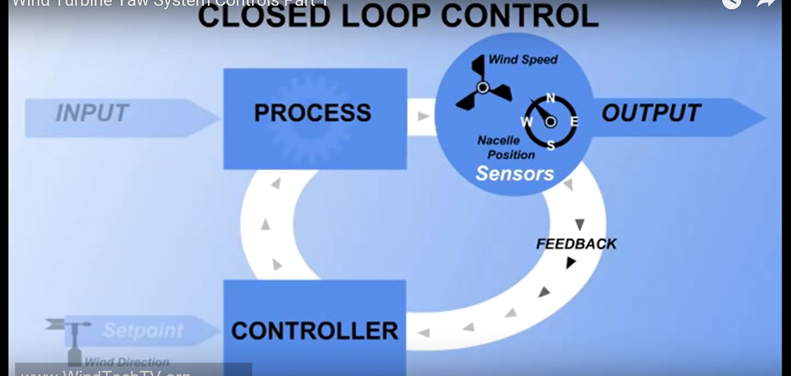
-Wind turbine yaw control system measures wind direction, wind speed and the current position of the turbine.
Measurements of these variables are made using sensors
Sensors is a device converts the physical quantities into an electrical signal such as volt, current or frequency that can be understood by the controller.
Information from the sensors is called feedback, feedback is used by the controller to make decisions and take actions to keep the wind system operating

Slide 5
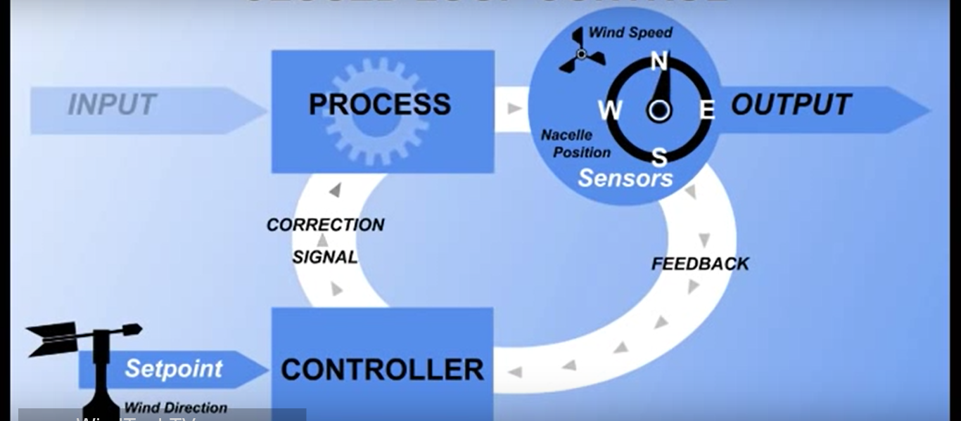
An important control function is to keep the turbine pointed into wind, so a simple instruction might be, if the wind direction differ from the direction turbine is pointing by more than 5 degree then turn the nacelle until it is aligned.
In this case the turbine aligned with the SETPOINT, to maintain it the controller receives a signal from the wind directional vane and compare it to the nacelle position sensor, if the wind direction and nacelle position are the same no action required and everything remain constant.
When the wind direction change, then is a difference bet. The SETPOINT and error signal is produced, the error signal is used by the controller to produce a correction signal that will sent to the actuators in motion to move the nacelle to the SETPOINT.

Slide 6
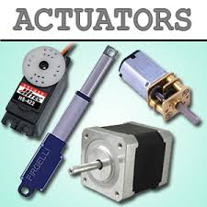
2
(Actuators),Devices such as electric motors or hydraulic cylinders that create motion and can be controlled with an electrical signal.
The main reasons to use yaw control system
1-To point the nacelle into wind for power generation.
2-To detect cable twisting resulting from yaw activity and unwind the cables as necessary.
3-To turn the nacelle away from the wind (FURLING)
FURLING:- it used to protect the turbine from high wind or to stop hub rotating for shut down. (ONE OF THE BREAKS TYPE).

Slide 7
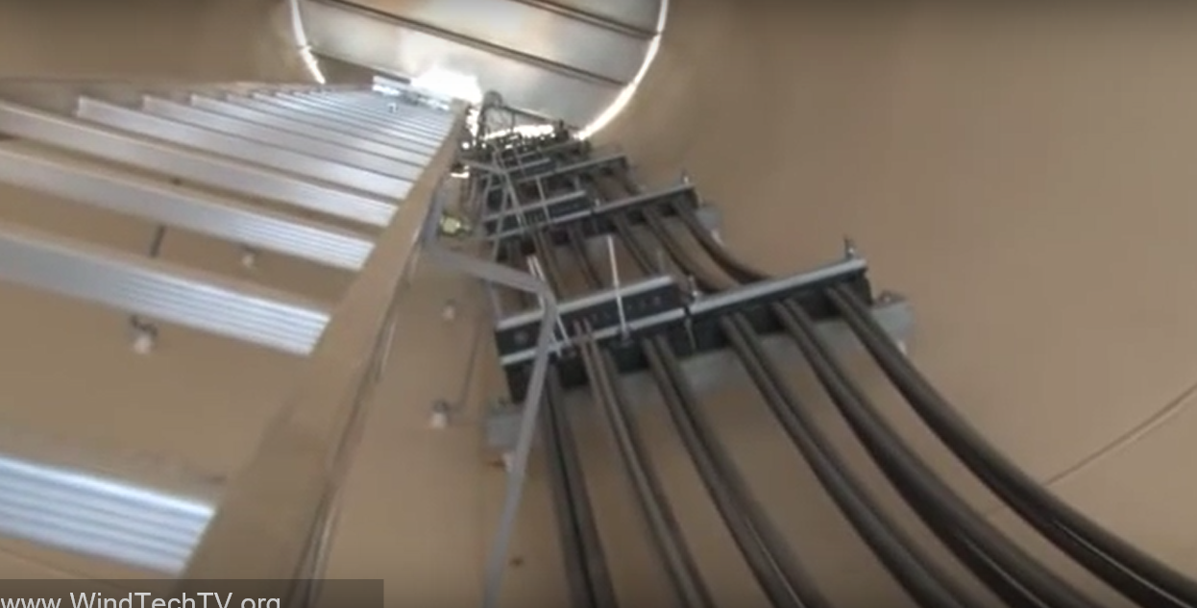
2-To detect cable twisting resulting from yaw activity and unwind the cables as necessary:-
As the nacelle tracks the wind the flexible power cables become twisted, but might untwisted as the wind changes direction.
Sensors detect nacelle rotation and the controller count the revolutions.
If the twist becomes excessive the controller will put the turbine into a stop state and rotate the nacelle to untwist the cables
If the nacelle is pointing 180 degree away from the wind, the controller will determine which direction will untwist the cable.
And then turn the nacelle in that direction to realign it with the wind.

Slide 8
3-To turn the nacelle away from the wind (FURLING)
it is used to protect the turbine from high wind or to stop hub rotation for shutdown
During normal operation when the wind speed is above 3 or 4 m/s the controller will keep the nacelle pointed into the wind and make corrections as the wind direction changes.
time of low or no wind it is not necessary to keep the nacelle pointing into the wind, in fact tracking the wind is too low to produce power results in unnecessary wear on the yaw system.

Slide 9
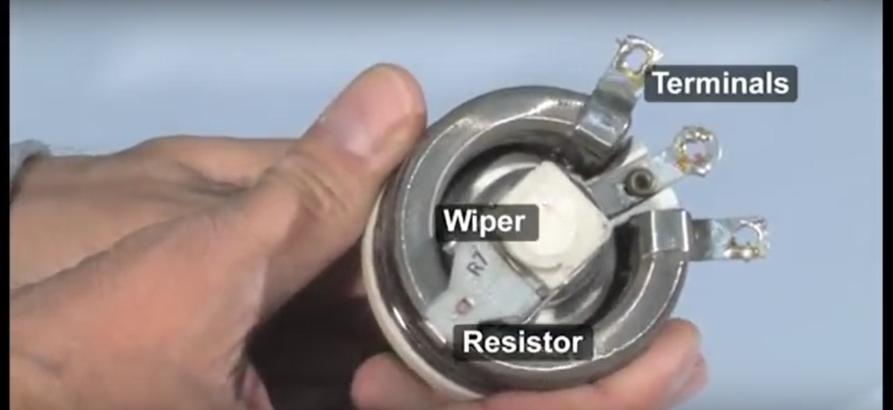
Sensors potentiometer, encodes, ultrasonic sensors may used to detect wind direction.
1-poteniometer:-
A variable resistor consisting of a resistive strip, three terminals and a movable wiper

Slide 10
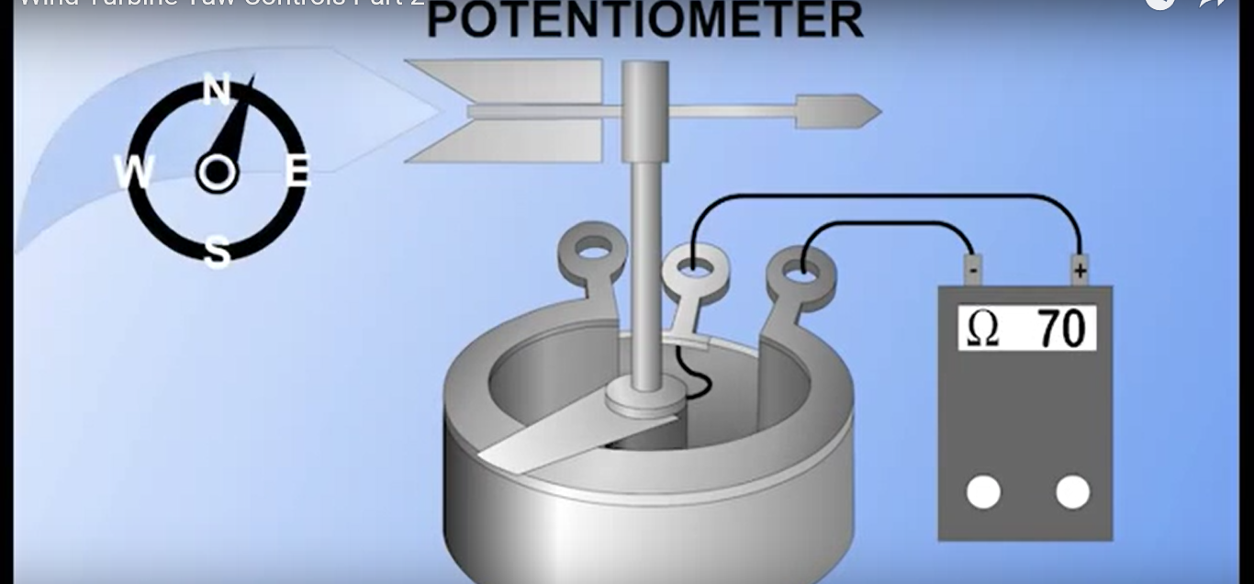
The movable wind vane is connected to a wiper, as the wind direction changes the vane moves the wiper across the resistive element and the output of the potentiometer changes in proportion to the wind movment.
Adv.
1- provide excellent linearity
2-simplicity
3-low cost

Slide 11
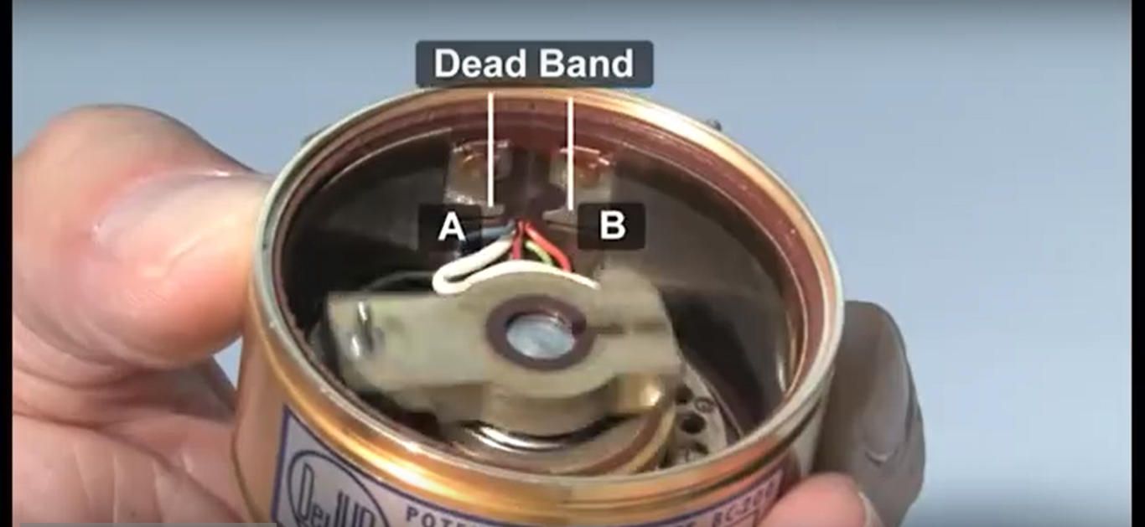
Disadv.
1- wiper wear that requires periodic replacment.
2-Dead band gap as a wiper crosses from point A to point B

Slide 12
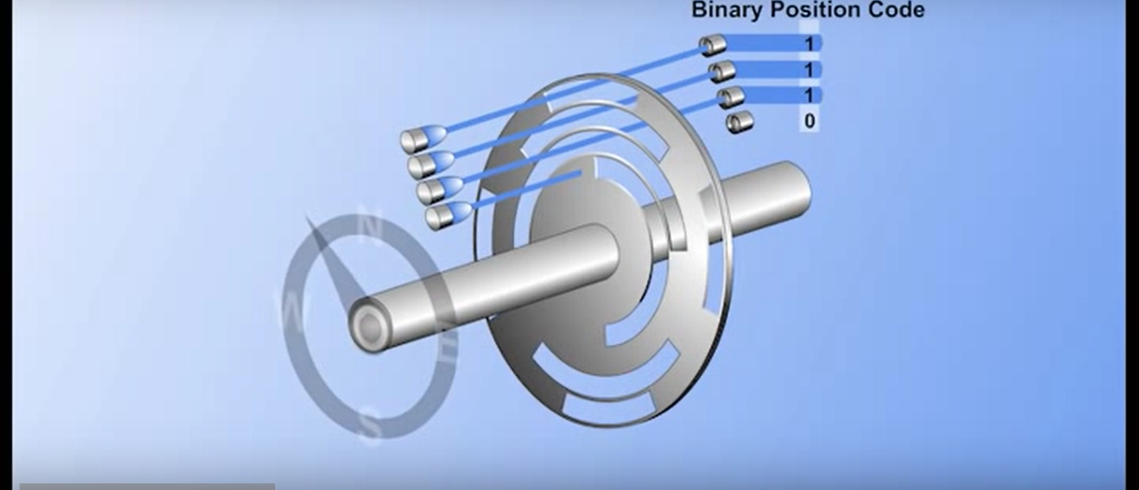
Encoders:-
-Consists of coated perforated disc, several light sources which an usually light emitting diodes and corresponding light detectors, a binary bit is produced when light passes through the disc and the detector is activated
-when each bit is grouped with bits from the other encoder tracks, absolute encoders can create many different binary position codes
-every code has a unique value that matches a position within the encoders 360 of rotation.

Slide 13
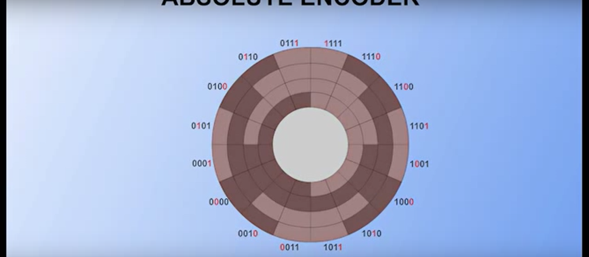
Wind direction detectors use disc constructed with special binary code called gray code
This special binary code used cause each change of position changes only one bit of the code
Gray code shown, the disc divides the nacelle 360 degree of rotation into 16 parts, each section represent 22.5 degree.

Slide 14
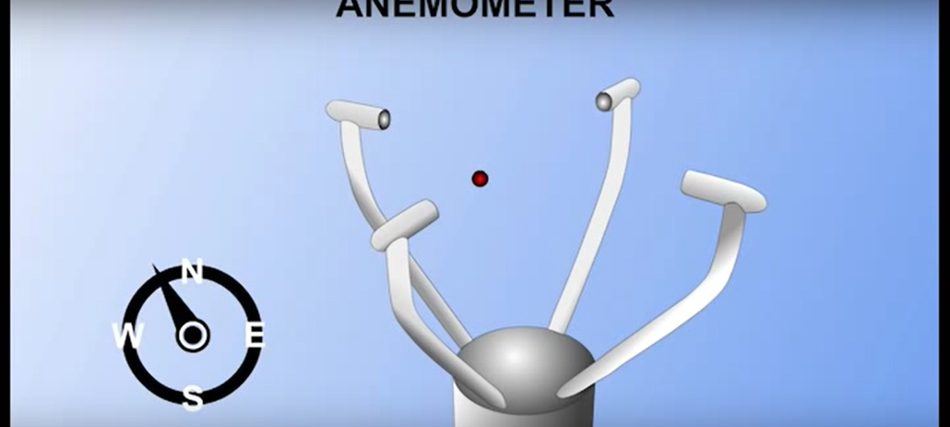
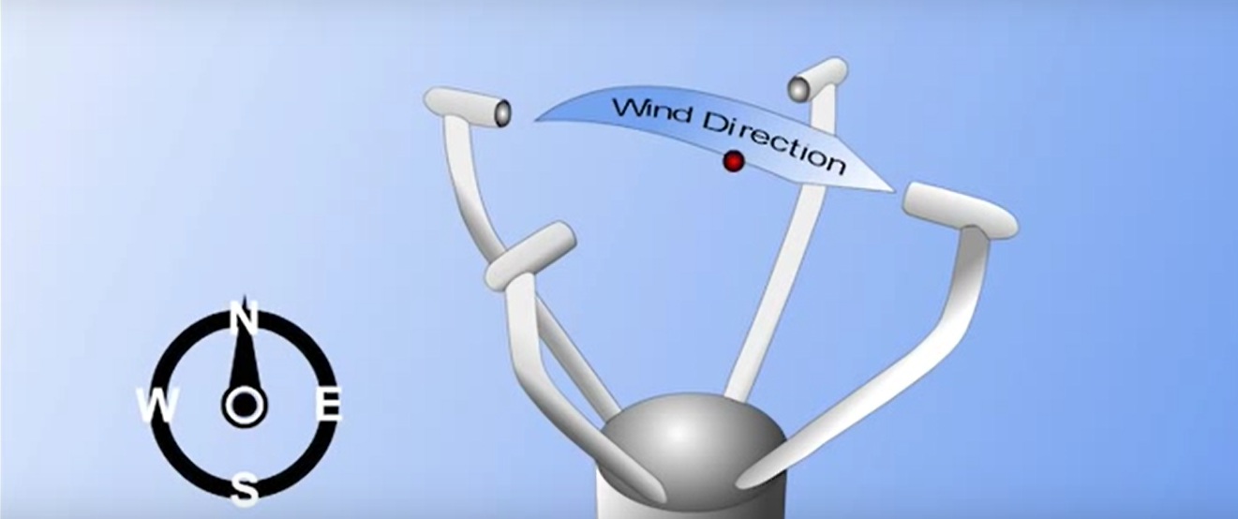
Ultrasonic anemometer:-
Uses sound wave to measure both wind direction and speed of wind
The time taken for an ultrasonic pulse to travel from one transducer to another
And then compares it with the time taken for another pulse to travel in the opposite direction

Slide 15
Yaw position sensors:-
To keep the turbine positioned into the wind the controller compares the wind direction to the direction of the nacelle
The yaw position sensors send this directional information to the controller
1-encoders
2-limit switches
3-proximity sensors

Slide 16
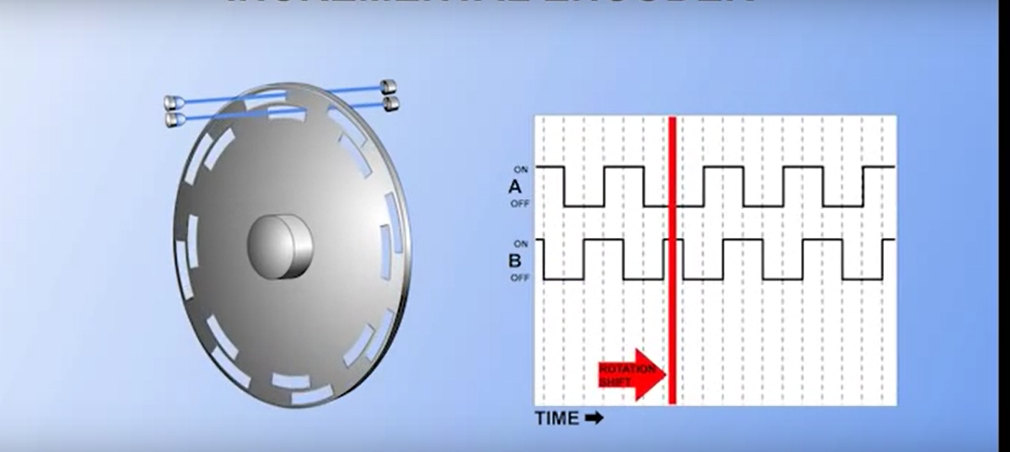
Incremental encoders:-
Similar to absolute encoders, except that instead of many light sources and detectors it only needs one or two.
By counting the no. of pulses produced the controller may calculate how far the nacelle ha yawned, may measure the distance of travel but not the direction of travel
To measure the direction another light source is added to encoders with offset
By monitoring which sensor turn on first the controller can determine the yaw clockwise or counter clockwise .

Slide 17
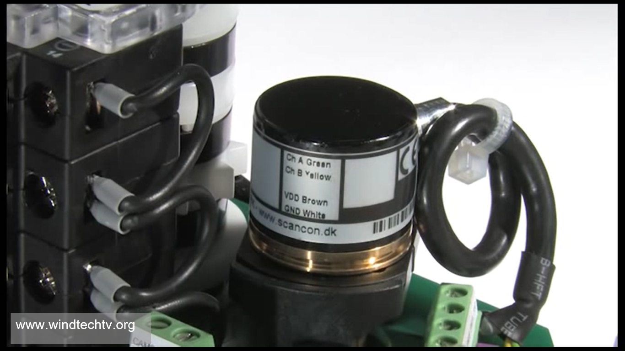
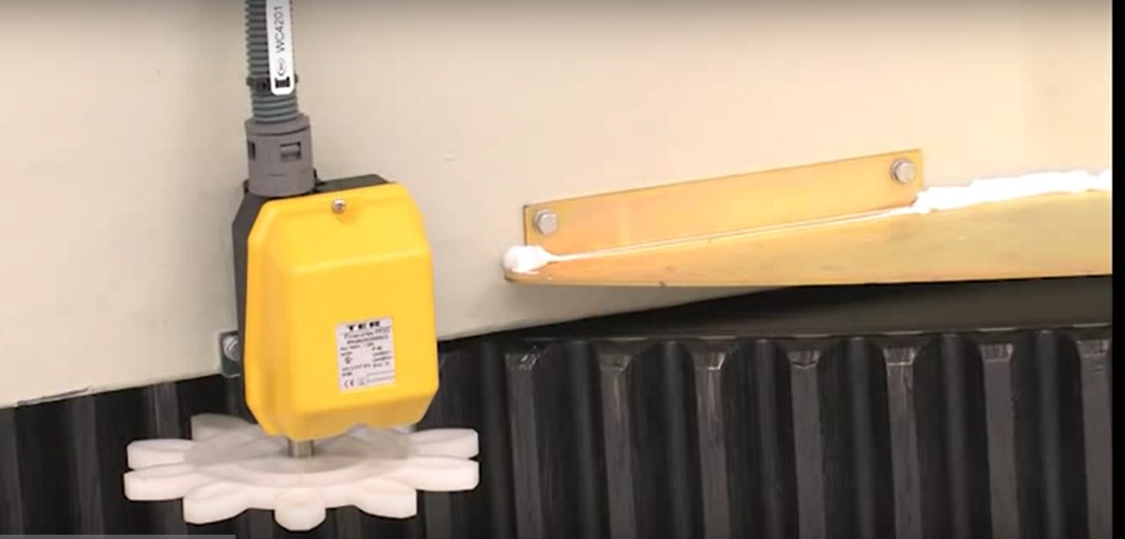
-The encoder is meshed with the yaw gear

Slide 18
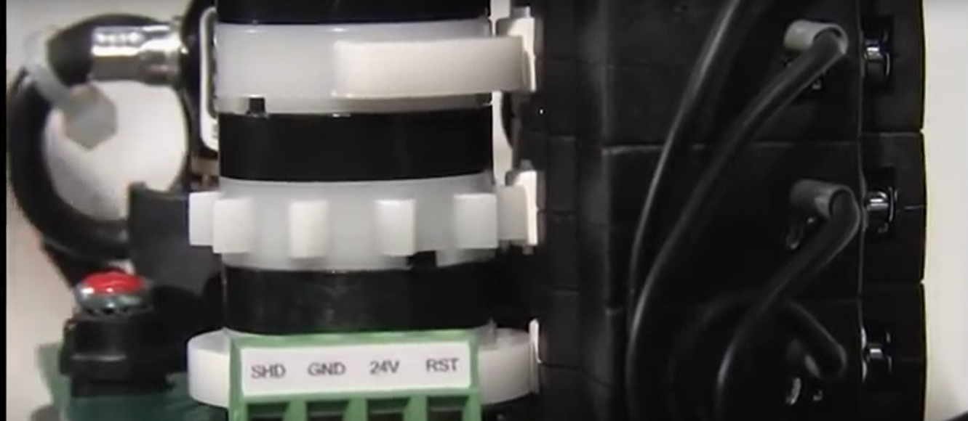
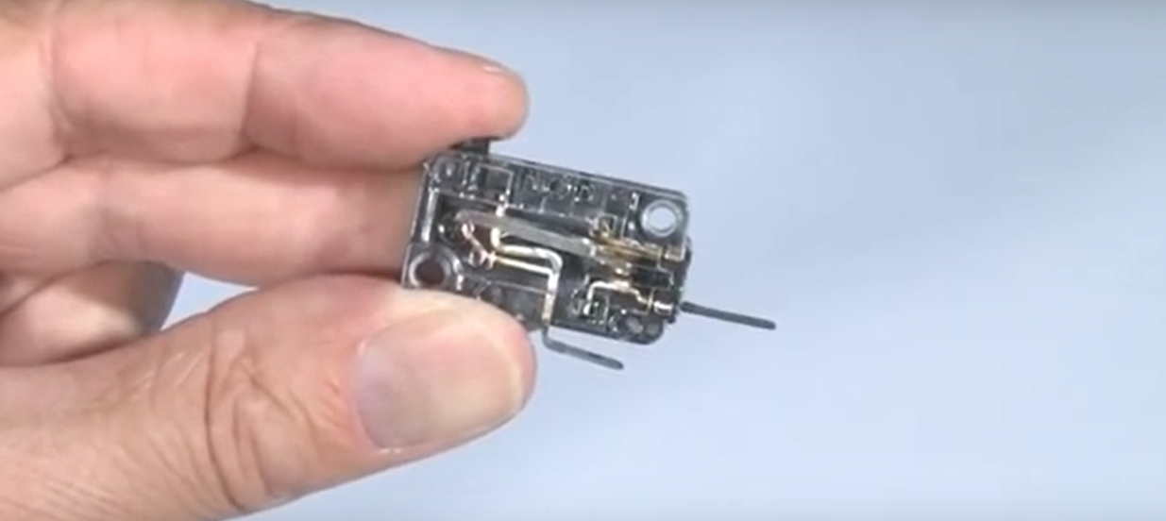
Limit Switches:-
It has the same idea of the encoders but without binary codes
The limit switches is connected to a cam shaft and this cam shaft push the switch and produce a signal

Slide 19
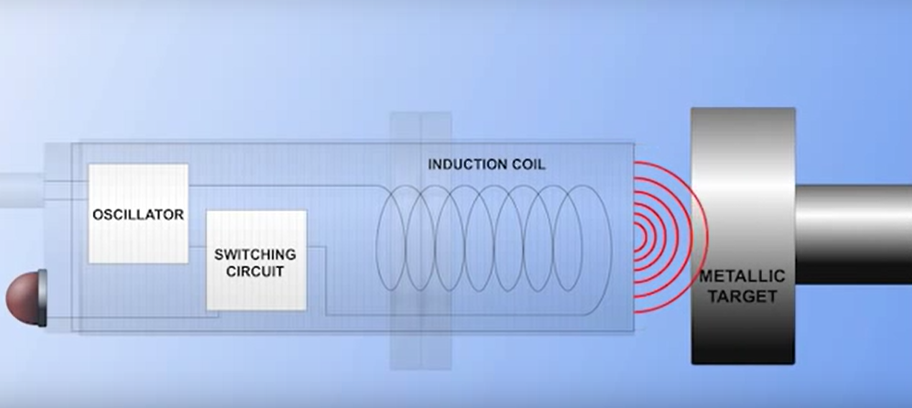
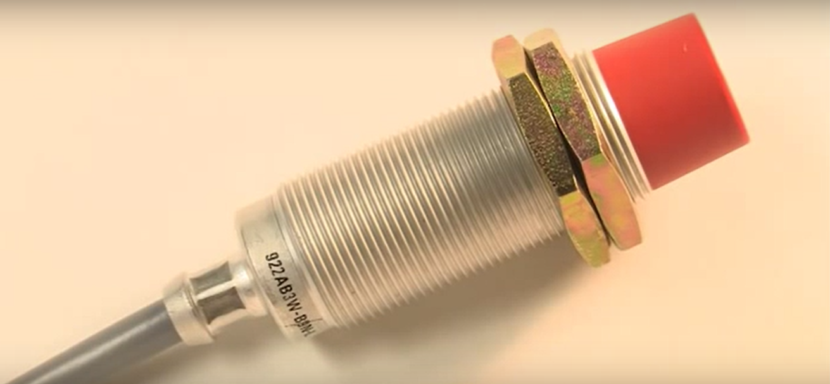
Proximity sensors (PROX sensor):-
They detect metallic targets such as cams, gear tooth
Inductive prox sensors designed to emit an oscillating magnetic field
When the metallic target enters the field the target absorb some of the field energy and the oscillation stop
This action triggers a switching circuit connected to the controller when the target is sensed the controller receive a signal that the target is placed.

Slide 20
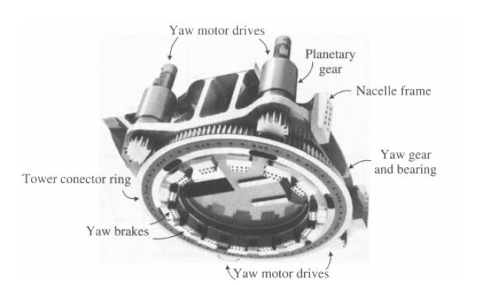

Slide 21
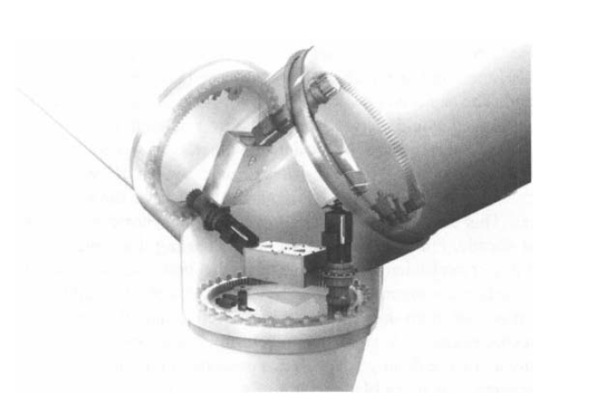
Pitching system

Slide 22
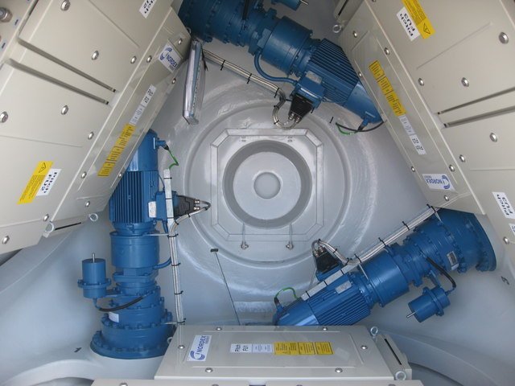
The pitch mechanism in large wind turbines enables the rotation of the blades on their longitudinal axis. It can change the angle of attack of the blades with respect to the wind, by which the aerodynamic characteristics of the blade can be adjusted.
This provides a degree of control over the captured power to improve conversion efficiency or to protect the turbine.
When the wind speed is at or below its rated value, the angle of attack of the blades is kept at an optimal value, at which the turbine can capture the maximum power available from the wind.

Slide 23
When the wind speed exceeds the rated value, the pitch mechanism is activated to regulate and limit the output power, thus keeping the power output within the designed capability.
For this purpose, a pitch range of around 20 to 25 degrees is usually sufficient.
When the wind speed increases further and reaches the limit of the turbine, the blades are completely pitched out of the wind (fully pitched or feathering), and no power will be captured by the blades. The wind turbine is then shut down and protected

Slide 24
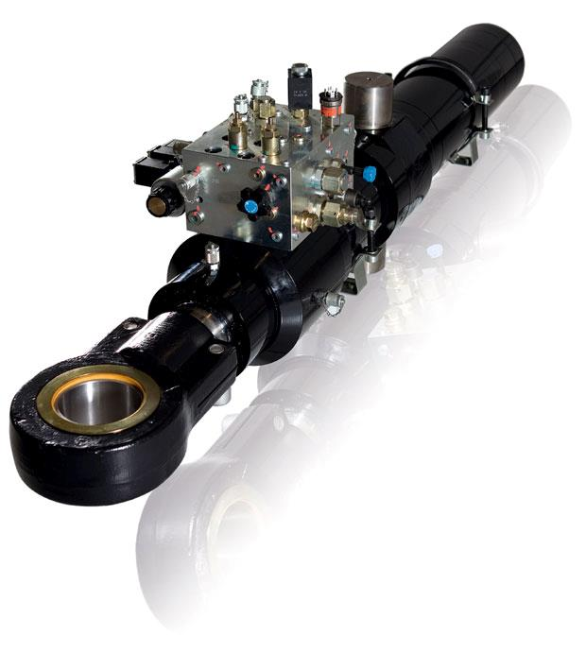
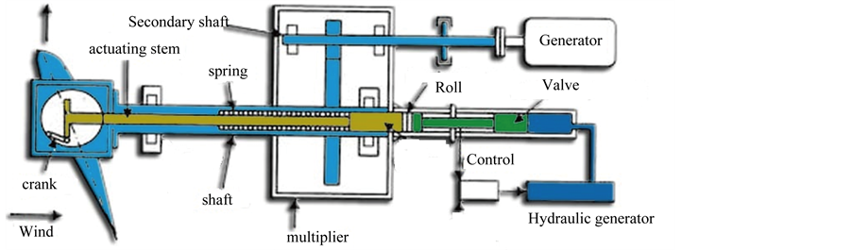
The pitch mechanism can be either hydraulic or electric. Electric pitch actuators are more common nowadays since they are simpler and require less maintenance.
Traditionally, all blades on the rotor hub are pitched simultaneously by one pitch mechanism. Modern wind turbines are often designed to pitch each blade individually, allowing an independent control of the blades and offering more flexibility.

Slide 25
Thanks ☺

